Slide 1
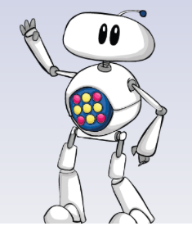
Welcome to MyMaths

Slide 2
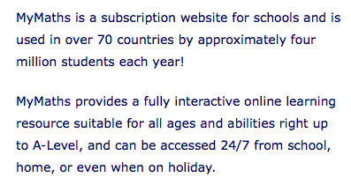

Slide 3
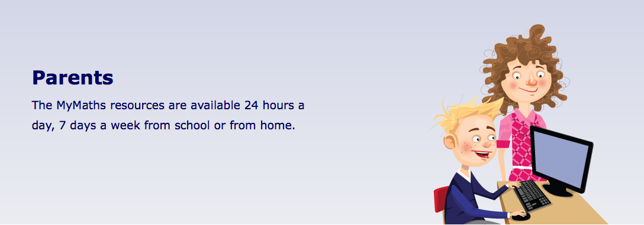
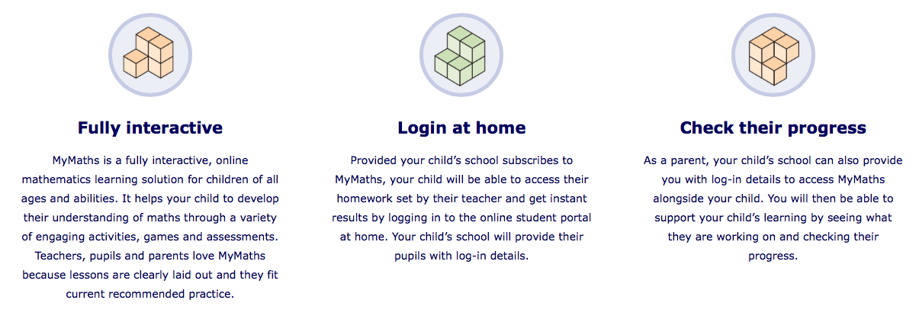

Slide 5
You can use mymaths to go over anything you are finding difficult in class or do homework your teacher has set. You will have a personal login if you have been set homework. See your teacher for the password.

Slide 6
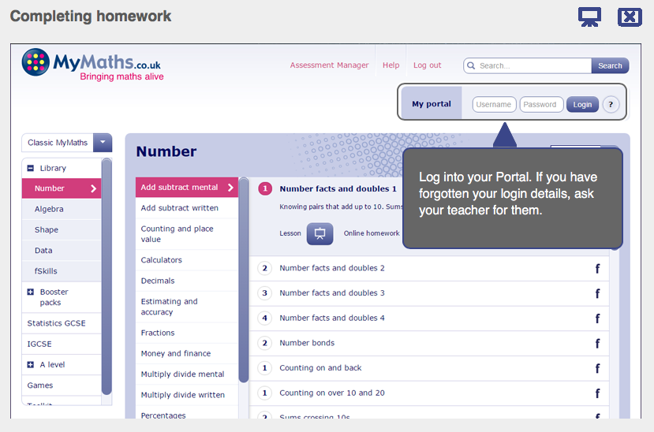
You can search any topic here you are finding difficult

Slide 8
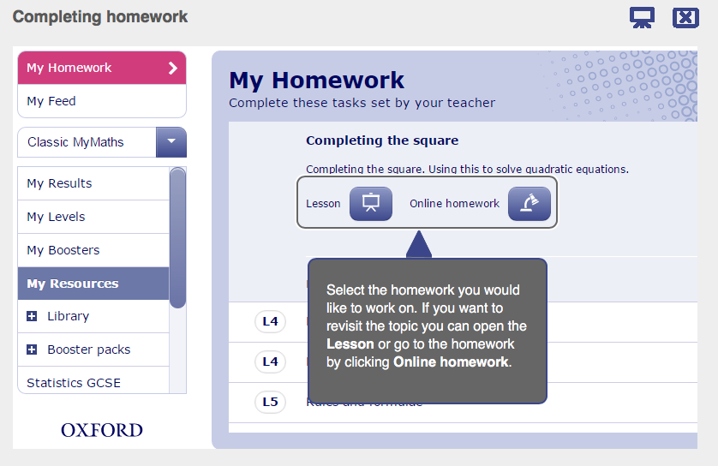

Slide 10
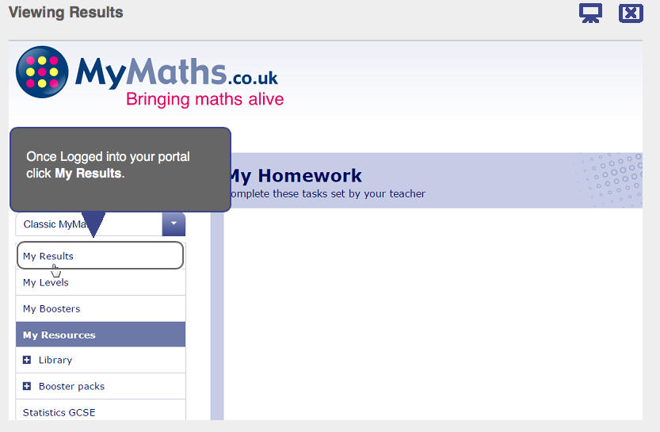

Slide 11
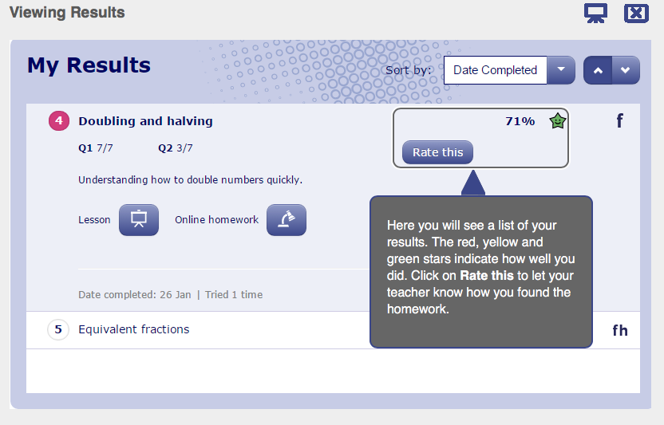

Slide 12
